Slide 1
CFA: Basics
Byrne Chapter 3
Brown Chapter 3 (40-53)

Slide 2
Other readings
Kline 9 – a good reference, but lumps this entire section into one chapter.
Brown 2 – great description of EFA procedures

Slide 3
CFA Models
EFA models
You have a bunch of questions
You have an idea (or sometimes not!) of how many factors to expect
You let the questions go where they want
You remove the bad questions until you get a good fit

Slide 4
CFA Models
CFA models
You set up the model with specific questions onto specific factors
Forcing the cross loadings be zero
(draw)
You test to see if that model fits
(so the C = Confirming the EFA).

Slide 5
CFA Models
General rules:
The latents will be correlated
Similar to an oblique rotation
Each factor section has to be identified
So remember the 1 on one of the paths if you don’t use the CFA button
Arrows go from latent to measured
We think that latent caused the measured answers
Error terms on the measured variables.

Slide 6
CFA Models
Generally, you leave the error terms uncorrelated
BUT!
These questions all measure the same factor right? So their answers on some will be tied to answers on another. So the errors may also be correlated.
You can get away with adding those here, if you have strong modification indices or theoretical reasons.

Slide 7
Let’s Try It
Four factor model, using byrne_3_one.txt

Slide 8
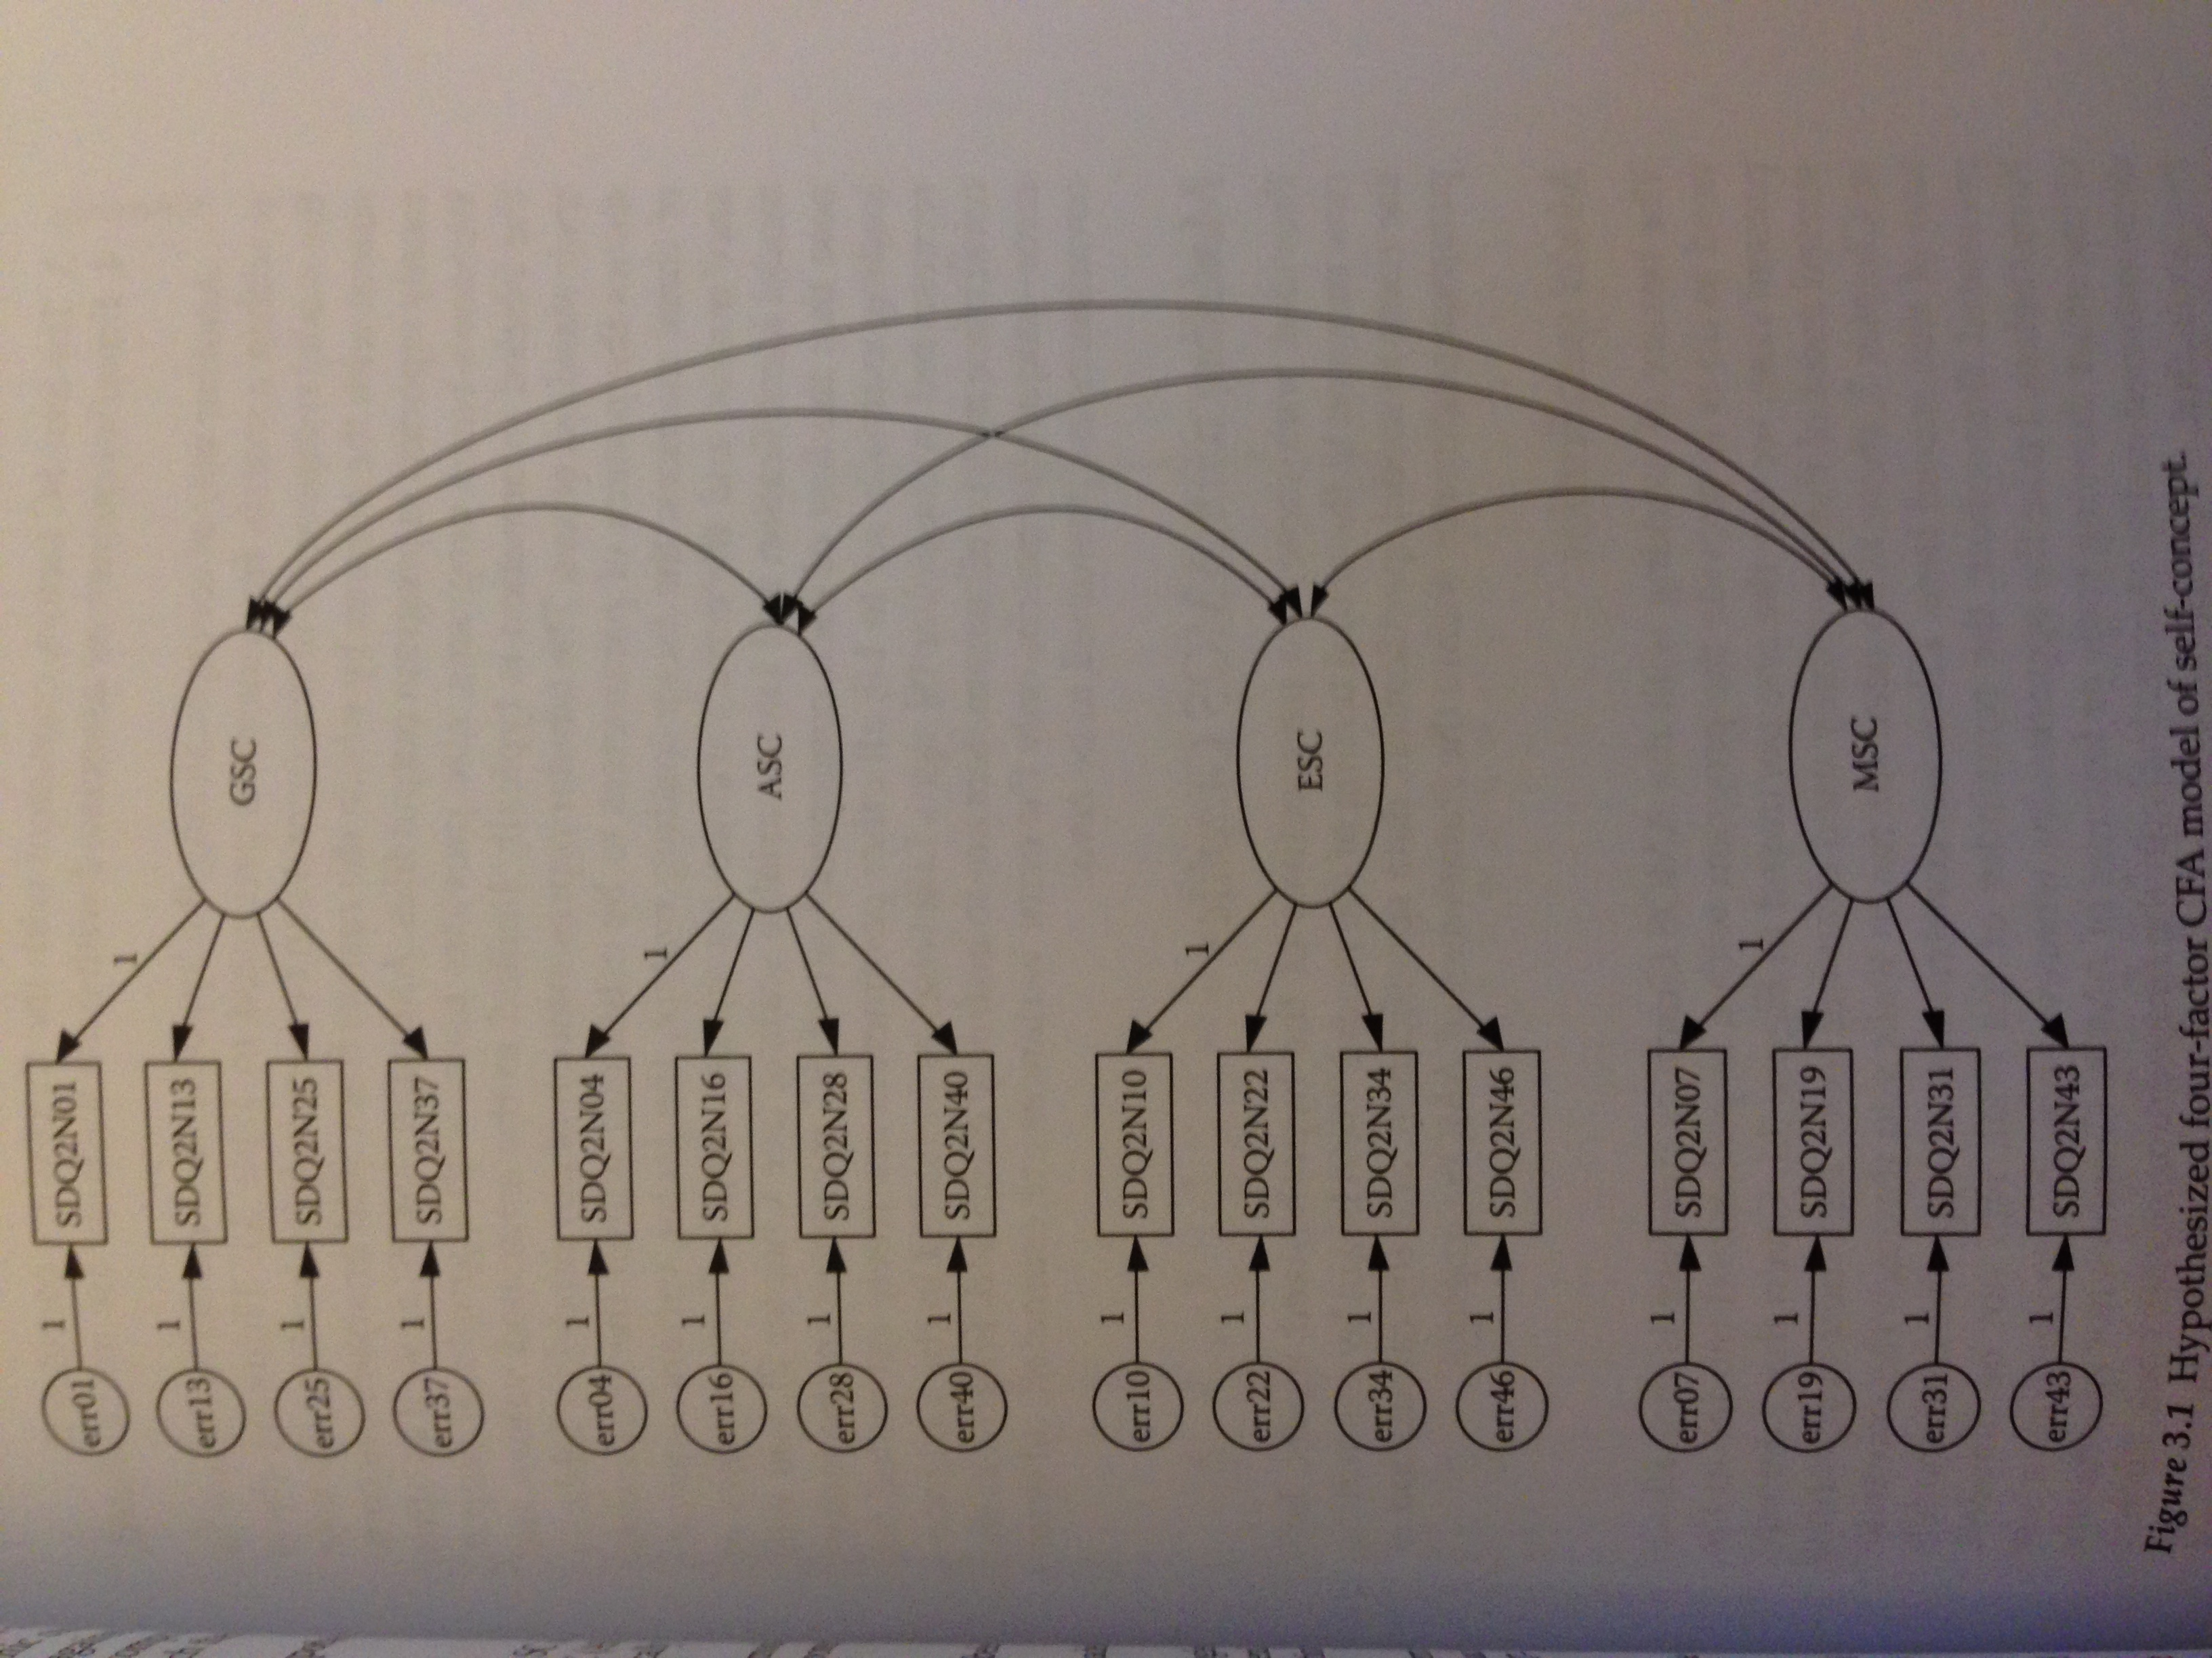

Slide 9
Things to check out
Notes for model
Did it run ok?
Estimates
Did our questions load?
Are our variances positive + SMCs ok?
Model fit
Are the fit indices any good?

Slide 10
Parameters
Remember – you want parameters that make sense
You can check out the standardized parameters to determine if questions are still loading like they would in an EFA.
CR = critical ratio = parameter / SE
CR = Z score

Slide 11
Parameters
Standard errors are tricky
They are based on the scale of the variable
You do not want them to be zero
Estimating no variance is bad … some variance is always good!
You do not want them to be large
That means you are not estimating very well

Slide 12
Model Fit
See previous notes but here’s a quick reminder:
X² nonsignificant (ha!)
RMSEA, SRMR = small numbers
CFI/NFI/TLI = large numbers

Slide 13
Model Fit
Standardized residuals
Hidden in the output options for analysis properties called residual moments
Don’t click on these (this is one of the things that crashes).

Slide 14
Model Fit
Standardized residuals
These are the discrepancies between the covariance matrix you created with the model and the covariance matrix of the actual data
>2.58 is considered a misfit
Z score for p < .01.
So that area is not being accurately represented.

Slide 15
Model Fit
So what do I do with that information?
Look for lots of misfit around questions that should load together on a factor. That indicates that maybe one isn’t working or is wanting to load on the other factor.

Slide 16
Model Fit
We talked about modification indices in the last section.
In this section – think about what they mean before adding paths.
Usually CFA is meant to test that specific question/latent combination, so it may not help to add the paths or correlate errors on two different latents.

Slide 17
Model Fit
Overfitted model – when you add parameters that help model fit, but do not help with theory (and probably won’t replicate)

Slide 18
Let’s try it
2-factor model of byrne_3_one.txt

Slide 19
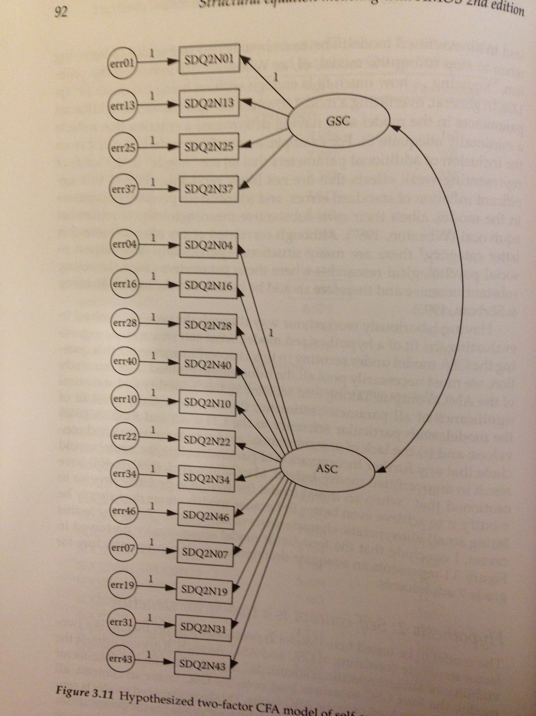

Slide 20
Let’s try it
1-factor model of byrne_3_one.txt

Slide 21
Compare the models!
Make a chi-square difference table
Chi square difference, df difference, critical chi square, reject?
Look at the AIC/ECVI
Which one is lower?

Slide 22
One more example!
PIL data!
Let’s pick a couple models to test…how many can there possibly be with 20 questions?

Slide 23
